Slide 1

Online Banking System
Sanyam Mahajan
G10 2010990644
End TERM Back-end Engineering
(CS187) Project
Using MERN

Slide 2
1
2
3
4
Introduction
Functions
Screenshots
Summary

Slide 3

Introduction
This project is made by keeping in mind the basic functionalities needed by
bank users for making hassle free banking.
The project consists of a home page which directs to you various different
services provided on the website like customer management, transaction
management etc.
It also includes basic CRUD functionalities which are must for any project.
It also consists of page which leads us the way to send or receive money
from different users.
Introduction

Slide 4





Basic functionality
Registration process / Login
Send Money
Forgot Password
User DashBoard
Home Page

Slide 5
Tehnologies Used: Frontend – HTML, CSS,JS, React, Bootstrap Backend – Node js Database – Mongodb
“
”

Slide 6
Modules Used
express
mongoose
bcryptjs
cookie-parser
react-toastify
jsonwebtoken
ReactDOM
React

Slide 7
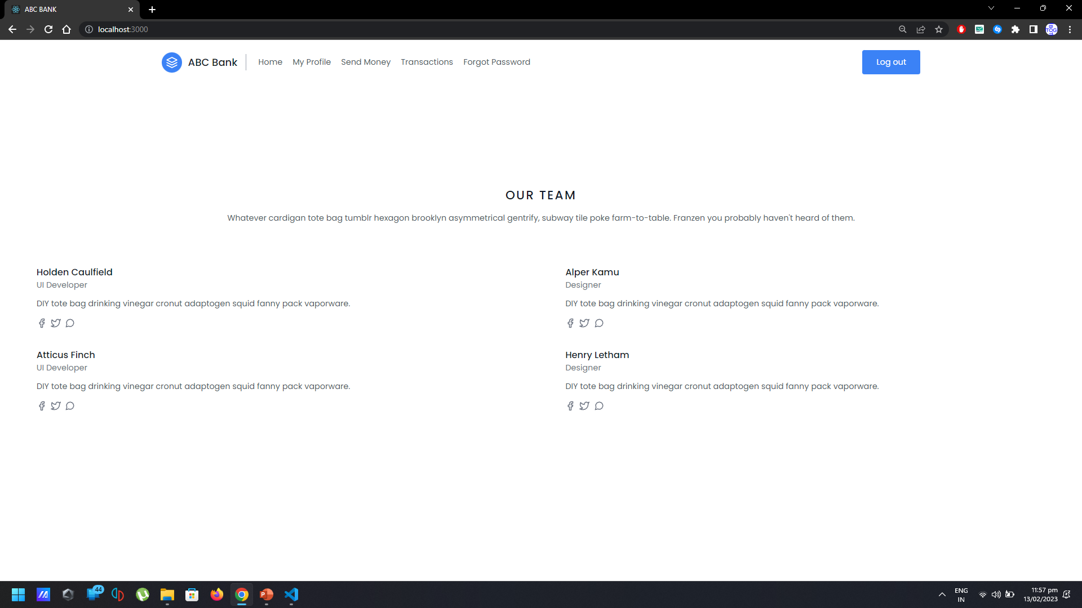
Home Page

Slide 8
NAV BAR

Slide 9
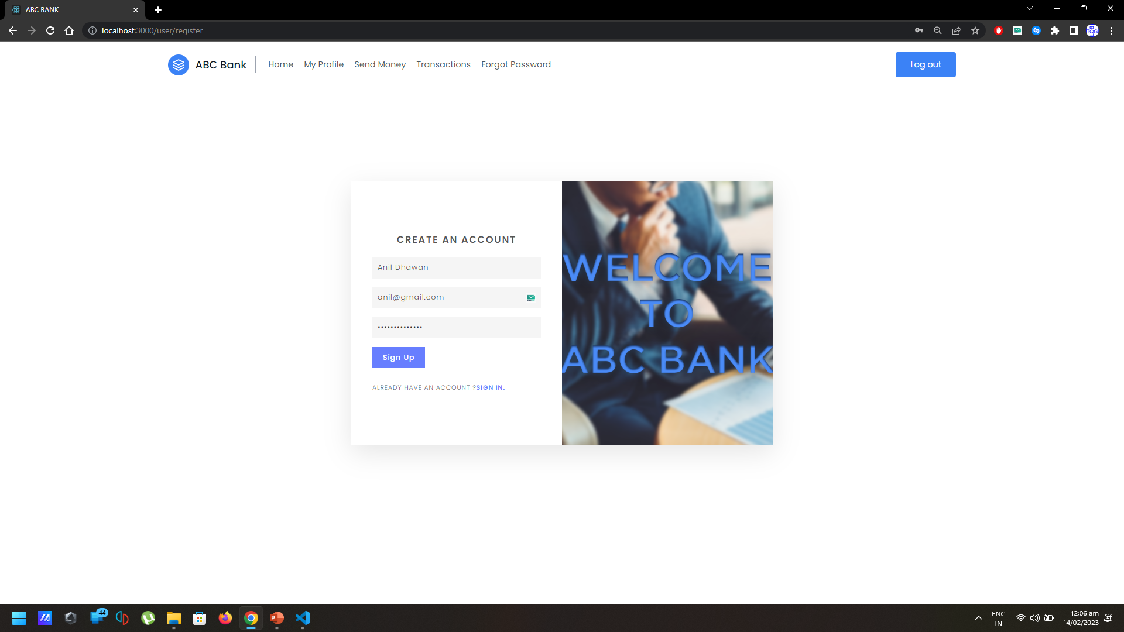
Sign up page

Slide 10
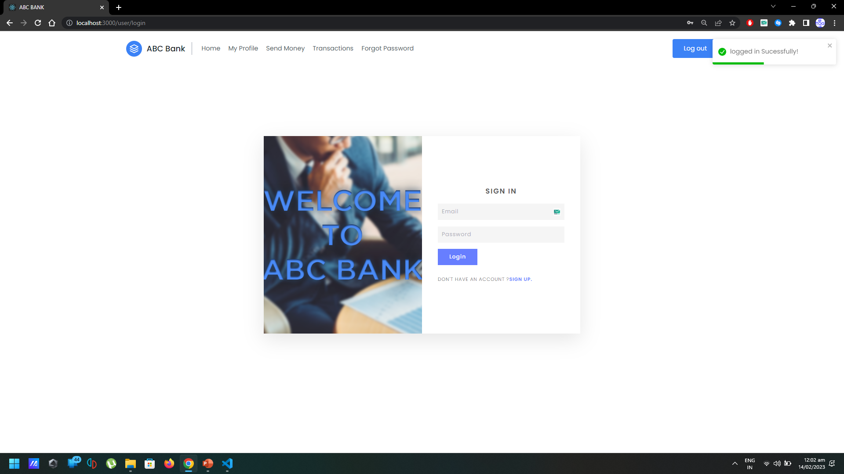
Login Page

Slide 11
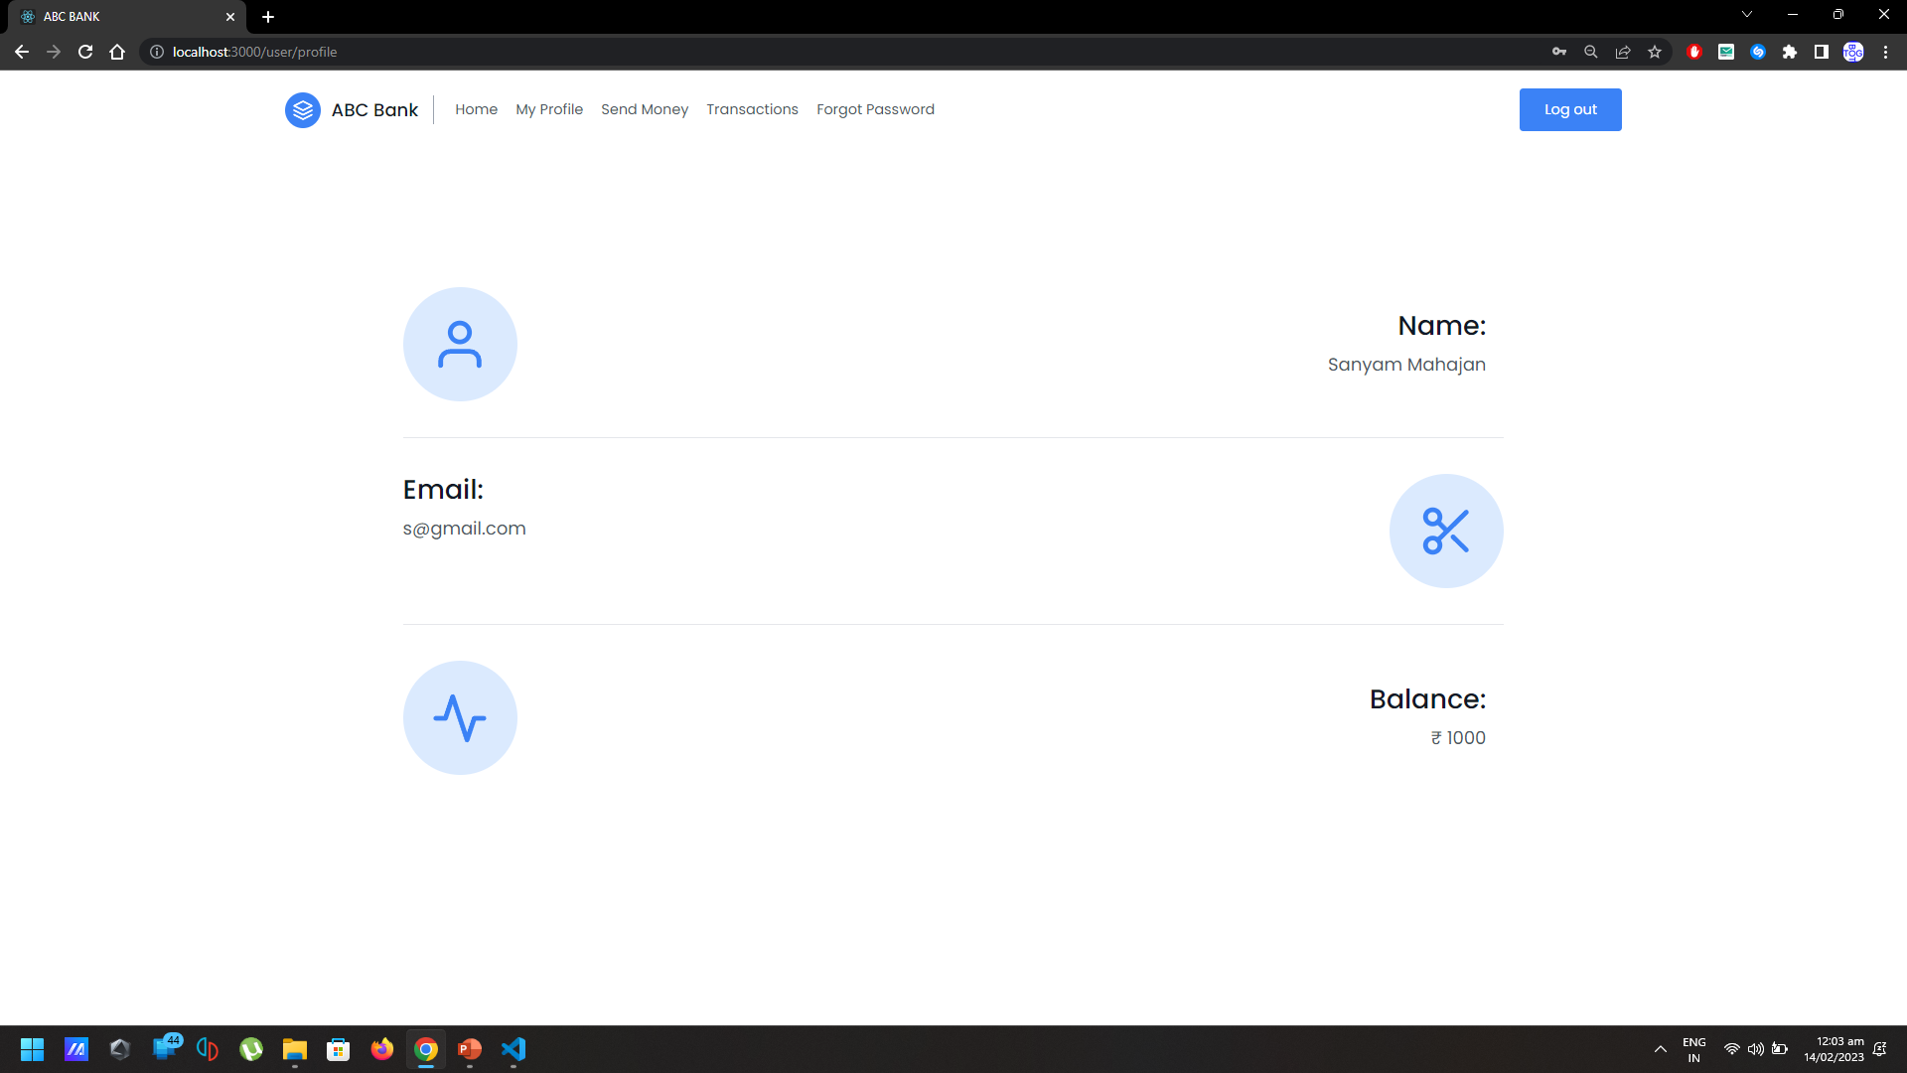
Profile

Slide 12
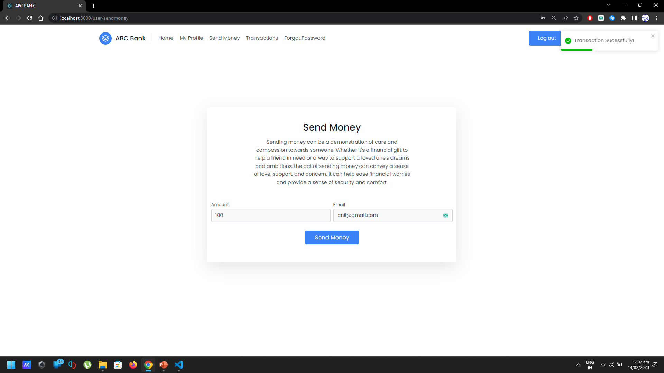
Send Money page

Slide 13
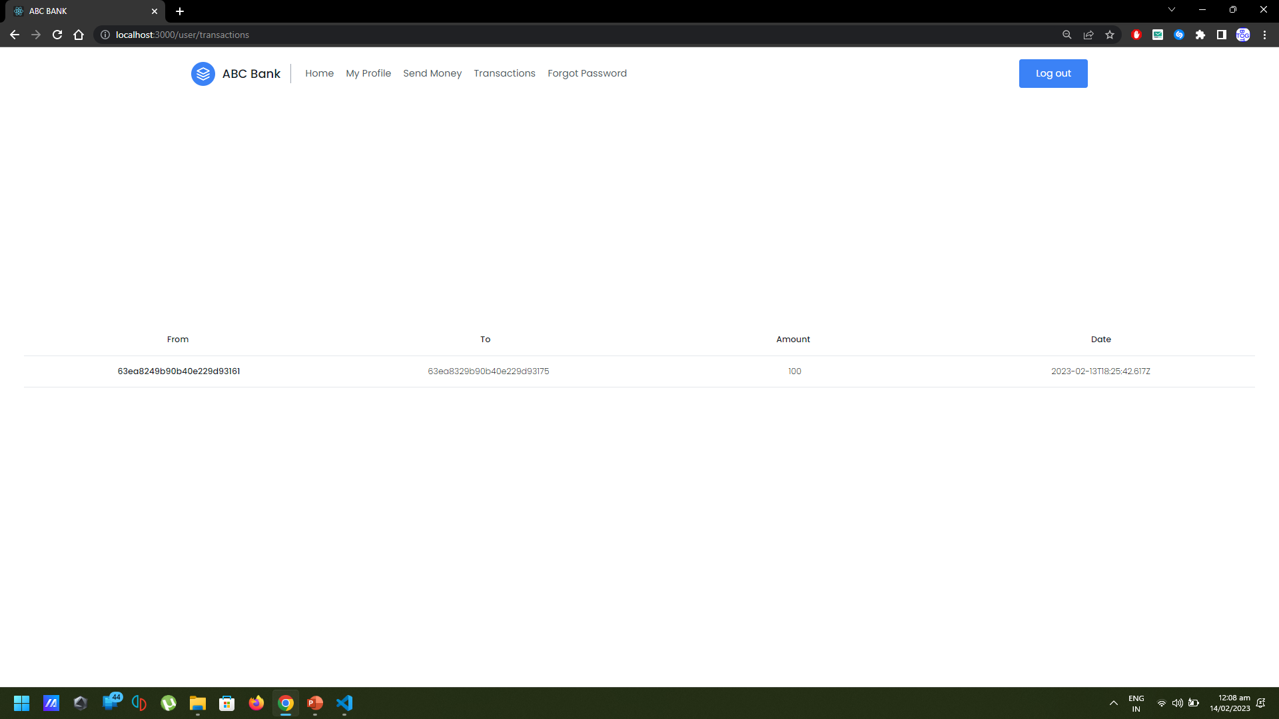
Transation Page

Slide 14
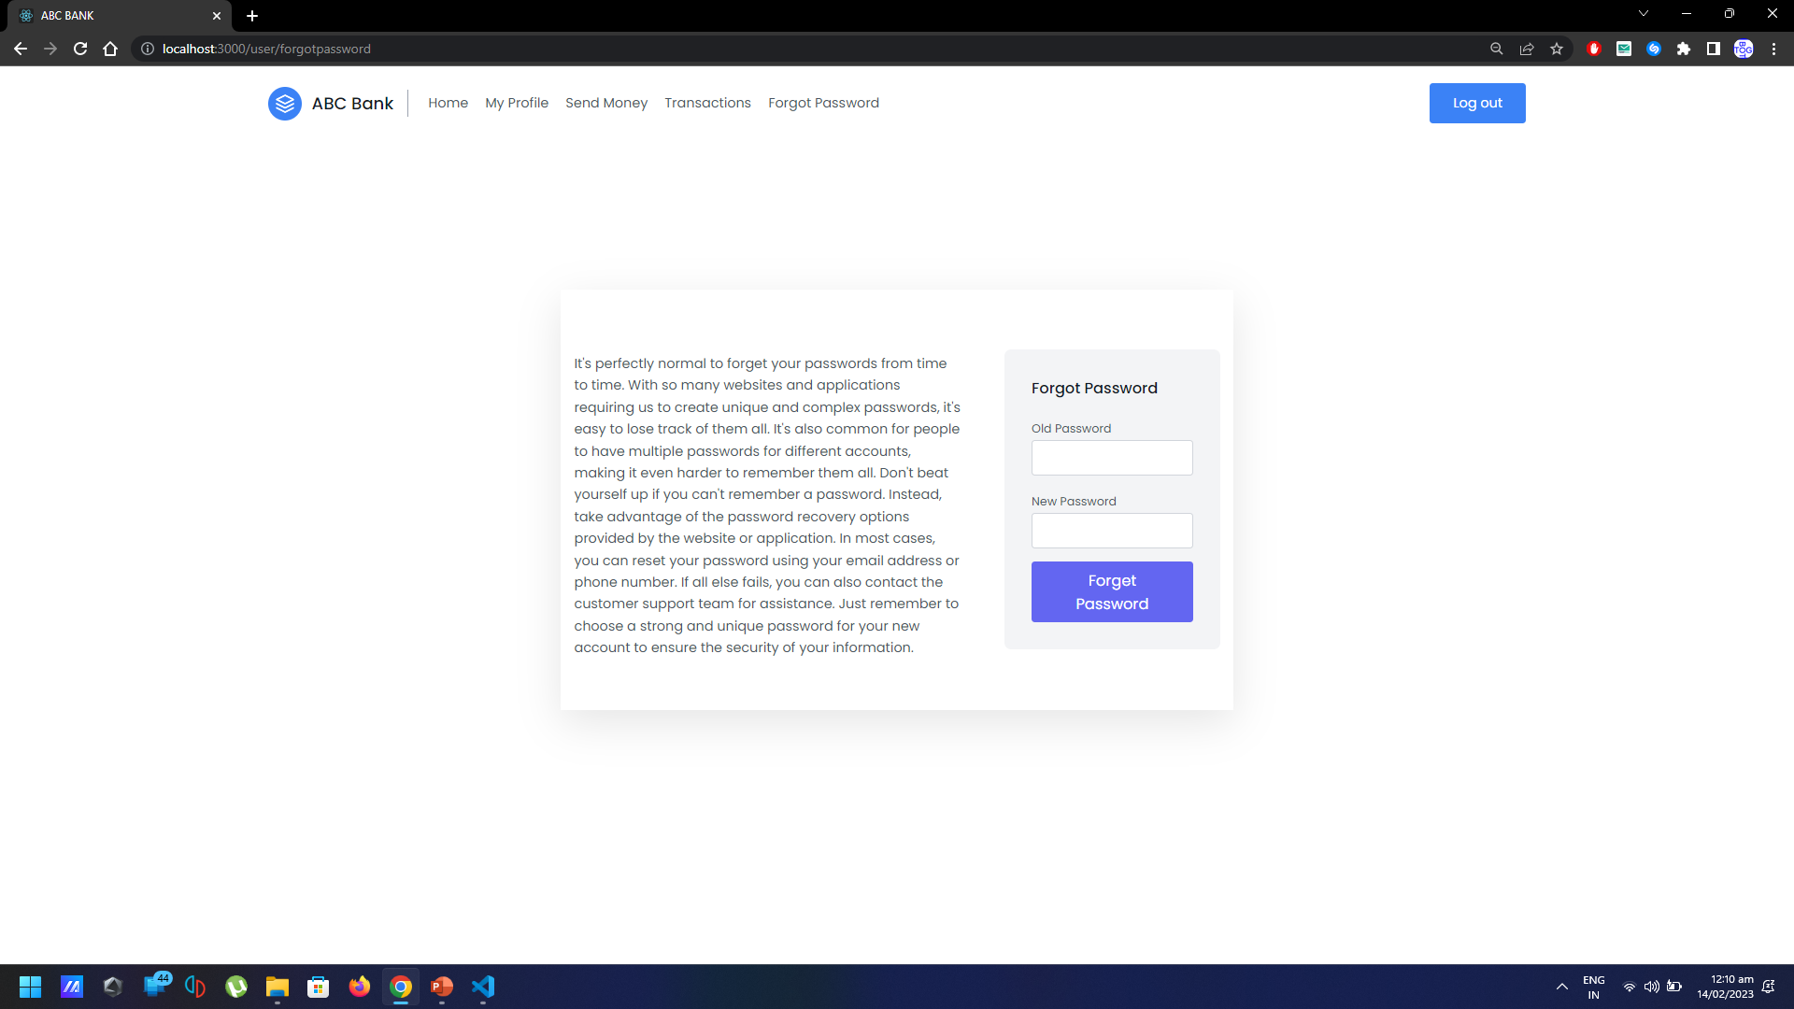
Forget Password Page

Slide 15
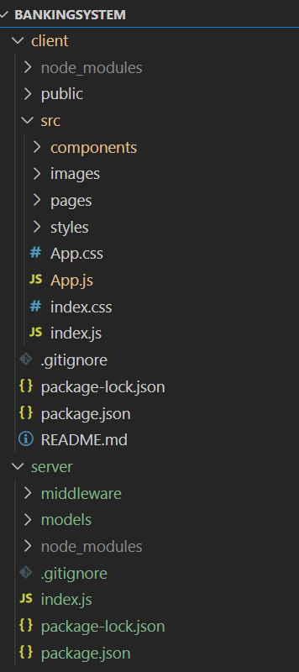
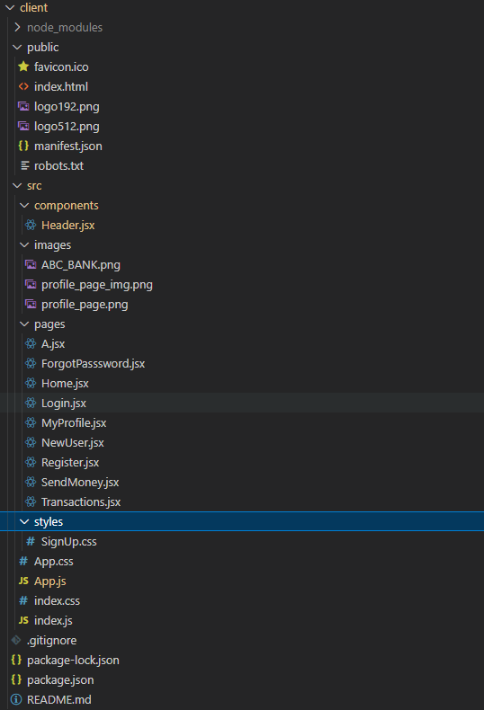
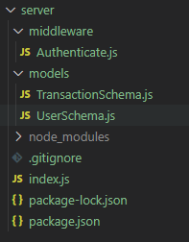
Folder Hierarchy

Slide 16
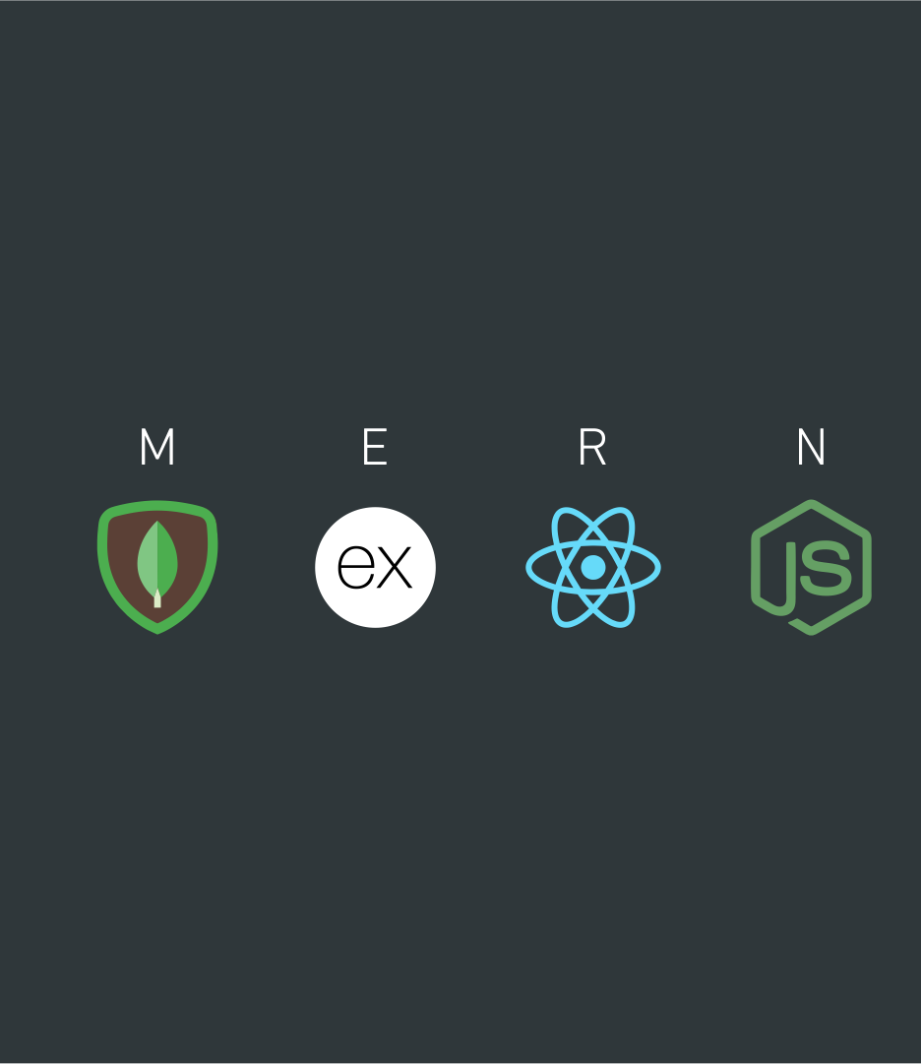
Summary
web-based banking application that is built using the MERN (MongoDB, Express.js, React.js, and Node.js) stack of technologies. MERN is a popular stack for building modern web applications due to its scalability, flexibility, and ease of use.
In a banking system built on MERN stack, MongoDB is used as the database management system to store and manage customer data, transaction details, and other financial information. Express.js is used to build the server-side APIs that provide access to the data stored in the database, while React.js is used to develop the user interface and handle user interactions. Finally, Node.js is used to run the server and execute the server-side logic.
The MERN stack provides several benefits for building a banking system, including fast and efficient data processing, real-time updates and seamless integration with other technologies, and a modern and user-friendly interface. Additionally, the open-source nature of the technologies in the MERN stack means that developers can access a large community of developers and a vast library of tools and resources to help them build and maintain their applications.
Overall, a banking system built on MERN stack offers a cost-effective, scalable, and flexible solution for delivering modern and innovative banking services to customers.

Slide 17
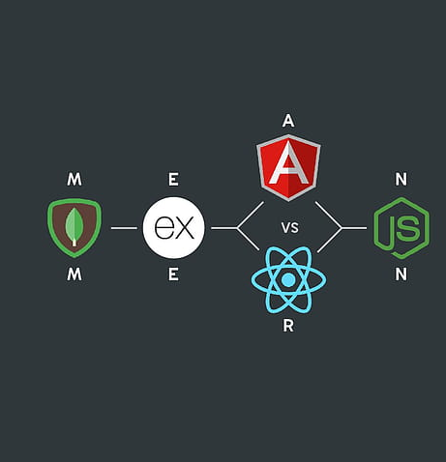
Thank you
Sanyam Mahajan
2010990644
G10

